Slide 1

Graduate Earnings Across Institutions and Programs
Abdul Bholat, Albert Carreno, Andrew Darwin, Anish Deshpande, Caleb Williams, Naren Prakash

Slide 2
Outline
Problem Statement & EDA
Earnings Benchmarks
UCLA vs. Other Institutions
Institution Level Analysis
Cohort Size & Earnings Trends
Questions
01
04
02
05
03
06

Slide 3

Abstract
This project examines how graduate earnings vary across academic programs and institutions, with a particular focus on UCLA as a benchmark for comparison. Specifically, we seek to answer two questions: (1) How does the number of graduates from UCLA’s degree programs compare to peer institutions? and (2) How does program scale affect post-graduation earnings? To address these questions, we compiled and merged datasets from the College Scorecard and IPEDS, filtering for recent and complete institutional and program-level data.
Our statistical approach involved imputation of missing values using linear regression for small gaps, and K-nearest neighbors for categorical variables. We then performed clustering on institutions based on control type, graduation rate, size, and selectivity to identify UCLA's peer groups. Regression analysis was used to evaluate the relationship between program scale (i.e., number of graduates) and median earnings, while controlling for institution type and field of study. Preliminary results suggest that scale is positively but weakly associated with earnings in fields such as Business and Computer Science (p < 0.05), but not in Engineering or Social Sciences (p > 0.1), indicating statistical significance only in some contexts.
A key challenge was addressing missing or inconsistent reporting in program-level earnings data, especially for smaller institutions or niche programs. Our next steps include incorporating cost-of-living adjustments to account for geographic wage differences and refining our regression models with interaction terms to capture nonlinear scale effects. These improvements will strengthen the causal interpretation of program scale on earnings and inform institutional decision-making.

Slide 4
Problem Statement
How do UCLA grads compare to peers from other institutions across degree types, fields of study, and institutional characteristics (program size, school type, region/state, tuition, etc.)?

Slide 5
EDA
-College Scorecard data contains aggregated metrics for variables, mostly handling missing values and ensuring numeric formatting
Look at just UCLA first, then compare with other programs
Evaluate how UCLA compares to:
Ivies / top ranked colleges
All CA schools
Similarly ranked colleges
National Averages

Slide 6
Variables
Institution Names and ID’s
CIP codes and descriptions
Median Earnings (1yr and 5yr)
Program-Specific
Debt After Graduation
Cohort Size per program
- Institution Data includes longer term outcomes
- Program-specific data focuses on short term

Slide 7
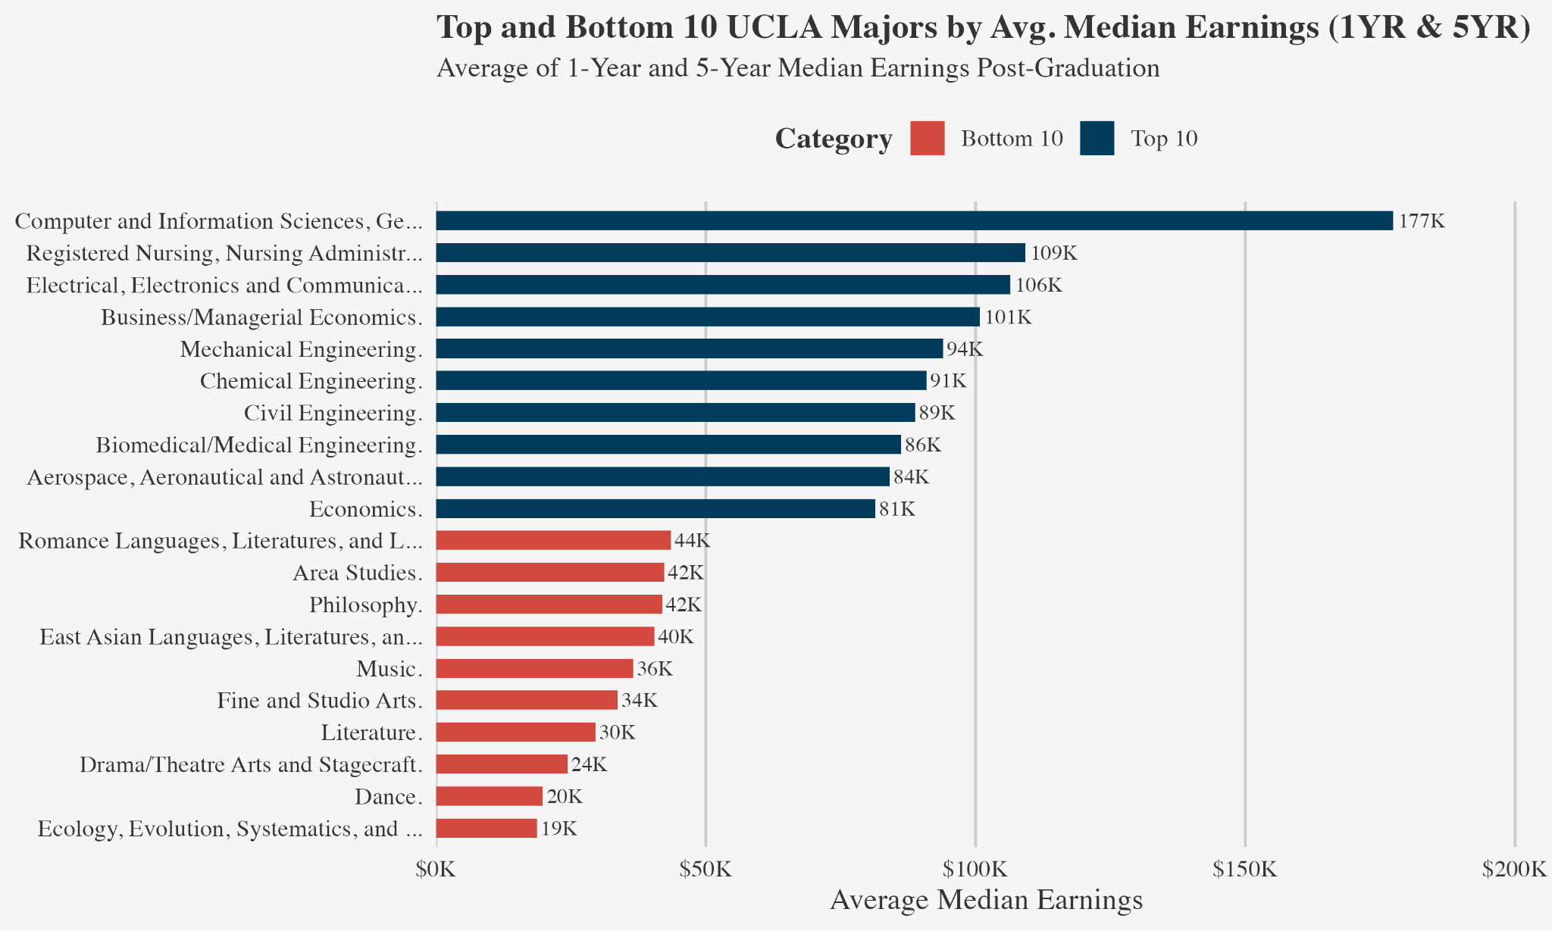
Notes:
Engineering + STEM at the top, Arts & Literature mainly compose bottom

Slide 8

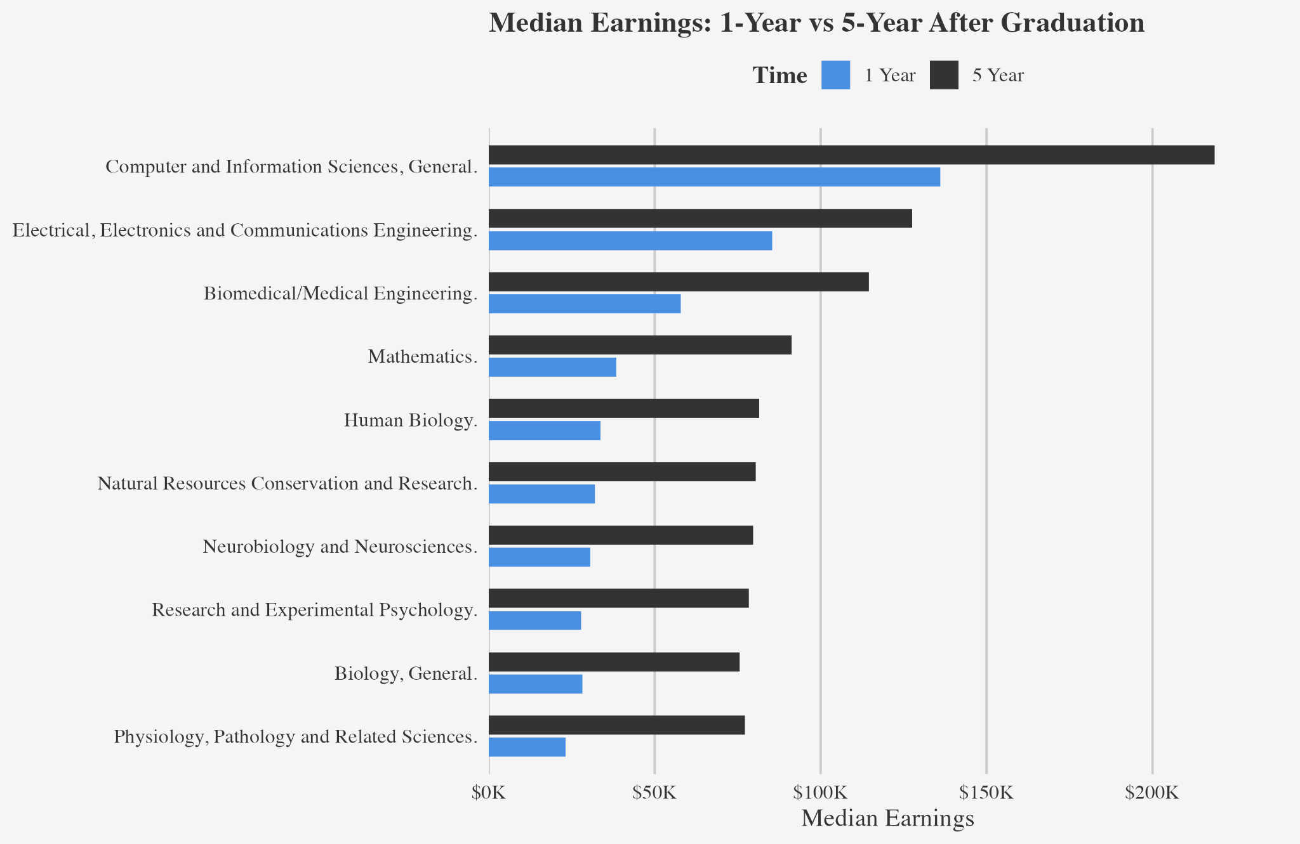

Majors with the most growth in median earnings from 1 year to 5 years after graduation
Notes:
Largest increases in earnings from 1 year to 5 years after grad, Engineering, Medicine & sciences,

Slide 9
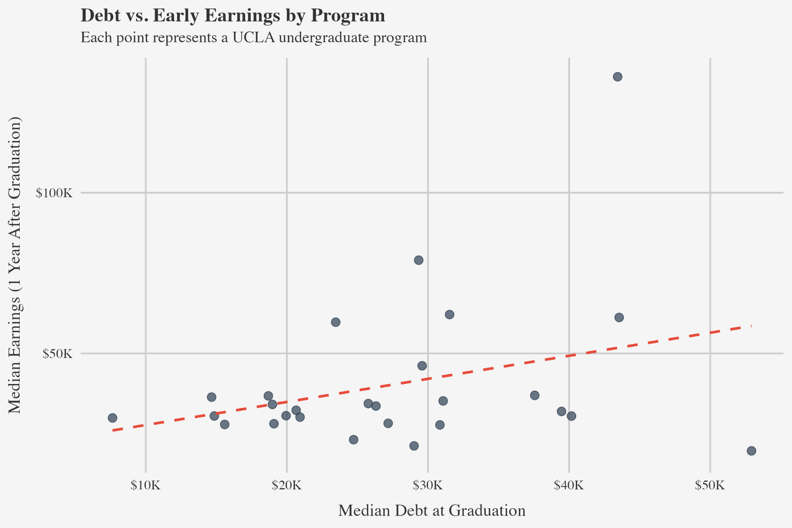
Plot of Median Debt at graduation vs. median earnings 1 year after graduation
Top right point is Computer science, bottom right is Theater arts
See linked dashboard for full labeling
Notes:
Not all programs have debt data, only 27 out of around 260 programs. This is just from the ones that do.
Top right is comp sci, bottom right is theater arts

Slide 10

Comparing UCLA to Other Institutions

Slide 11

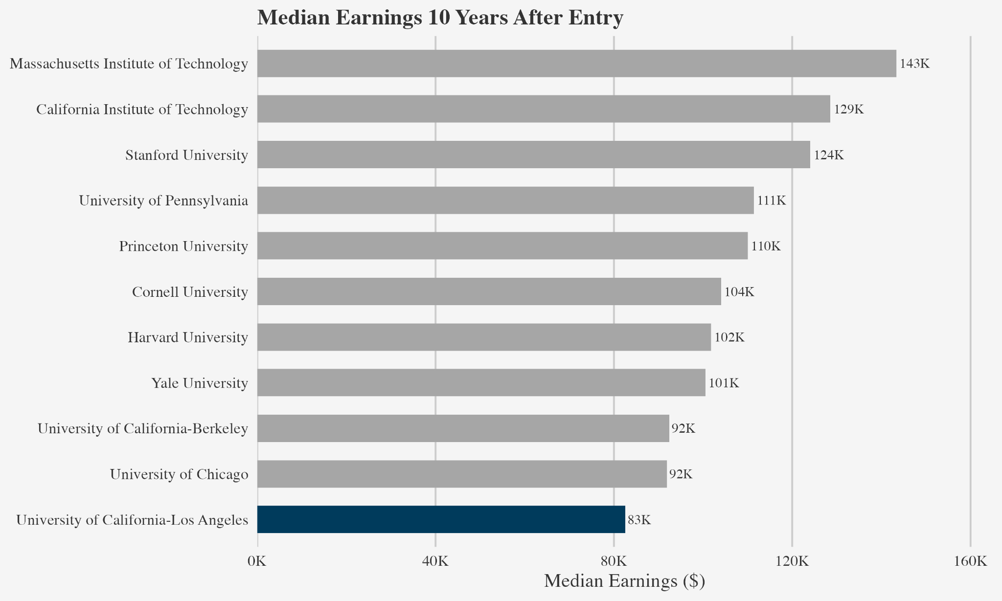
UCLA vs. Top 10 Nationwide Schools

Slide 12

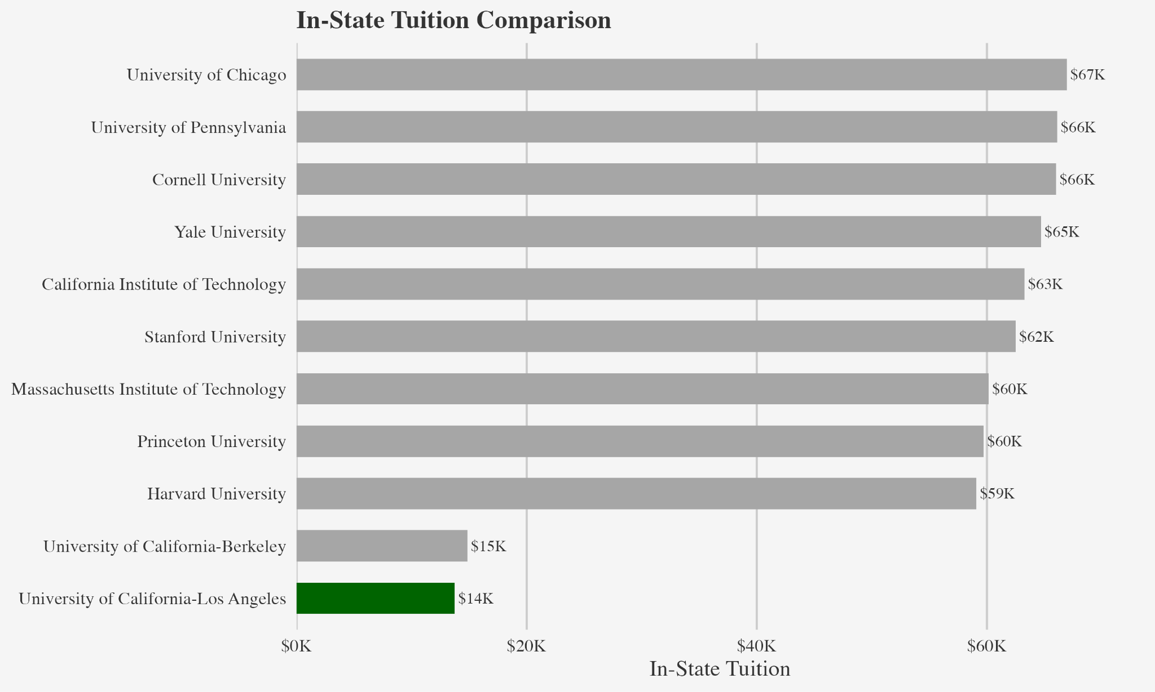
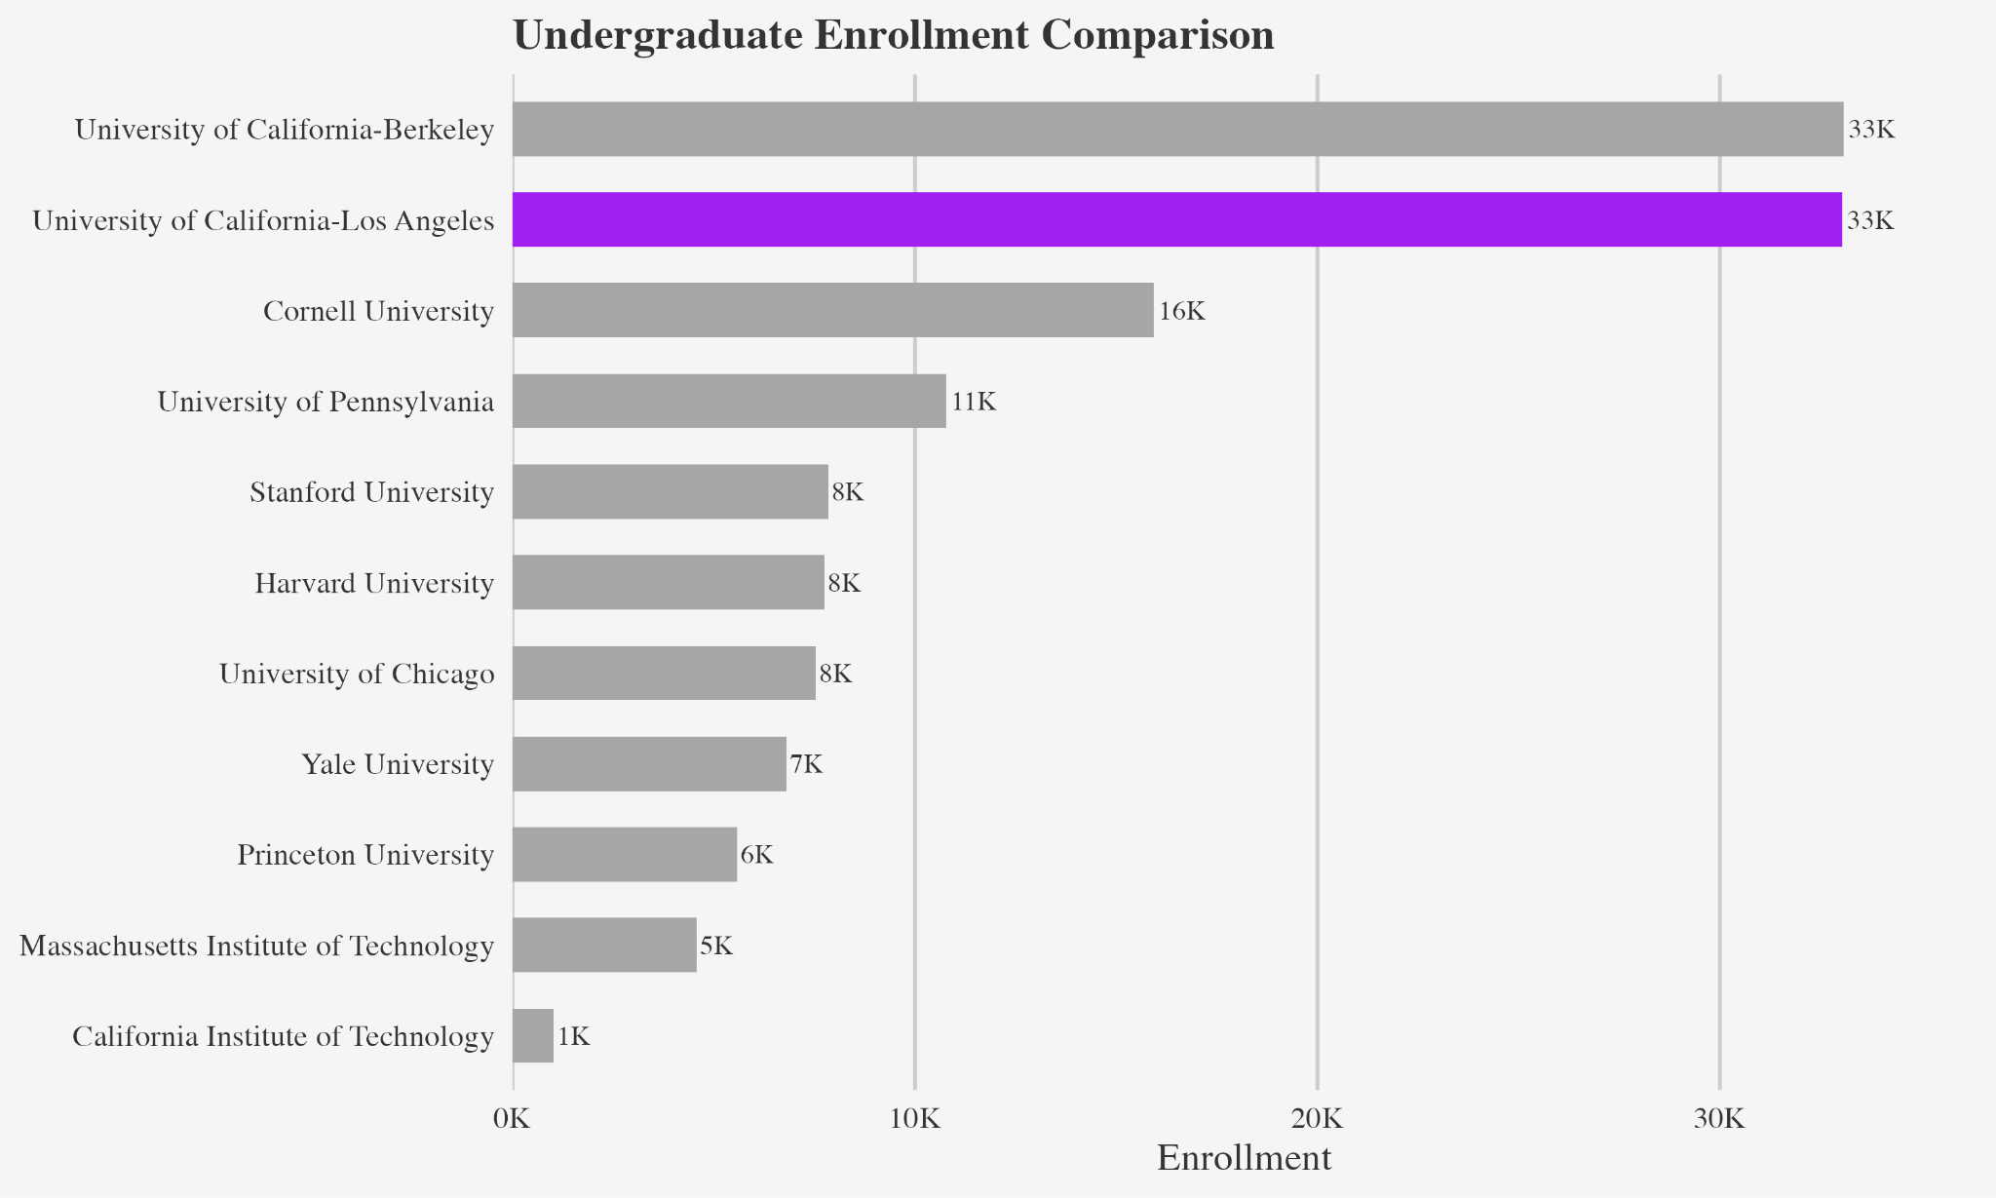
Other Comparisons to Top 10 Schools
https://www.usnews.com/best-colleges/rankings/national-universities/top-public?_sort=rank&_sortDirection=asc
https://www.topuniversities.com/world-university-rankings

Slide 13

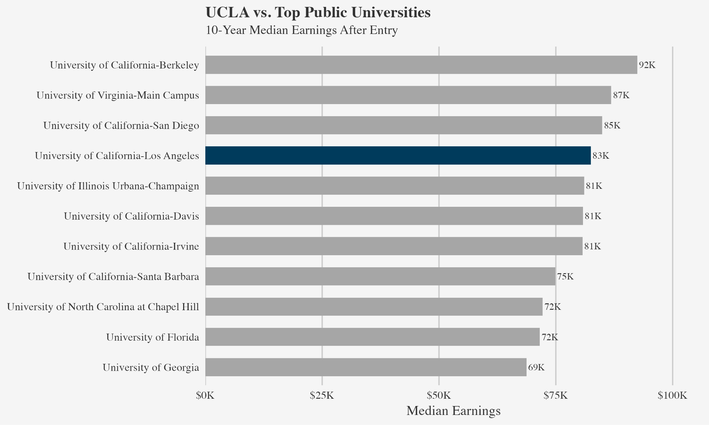
UCLA vs. Other Top Public Schools

Slide 14

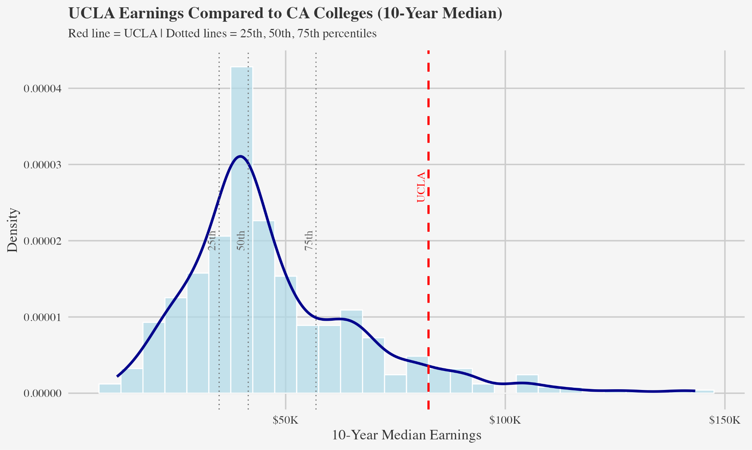
UCLA vs. California Schools
- 671 CA Schools being compared to UCLA, 93rd percentile
~ 45 schools placing above UCLA in California for median income after graduation, including:
- Harvey Mudd, Stanford, Cal Tech, USC, UC Berkeley

Slide 15

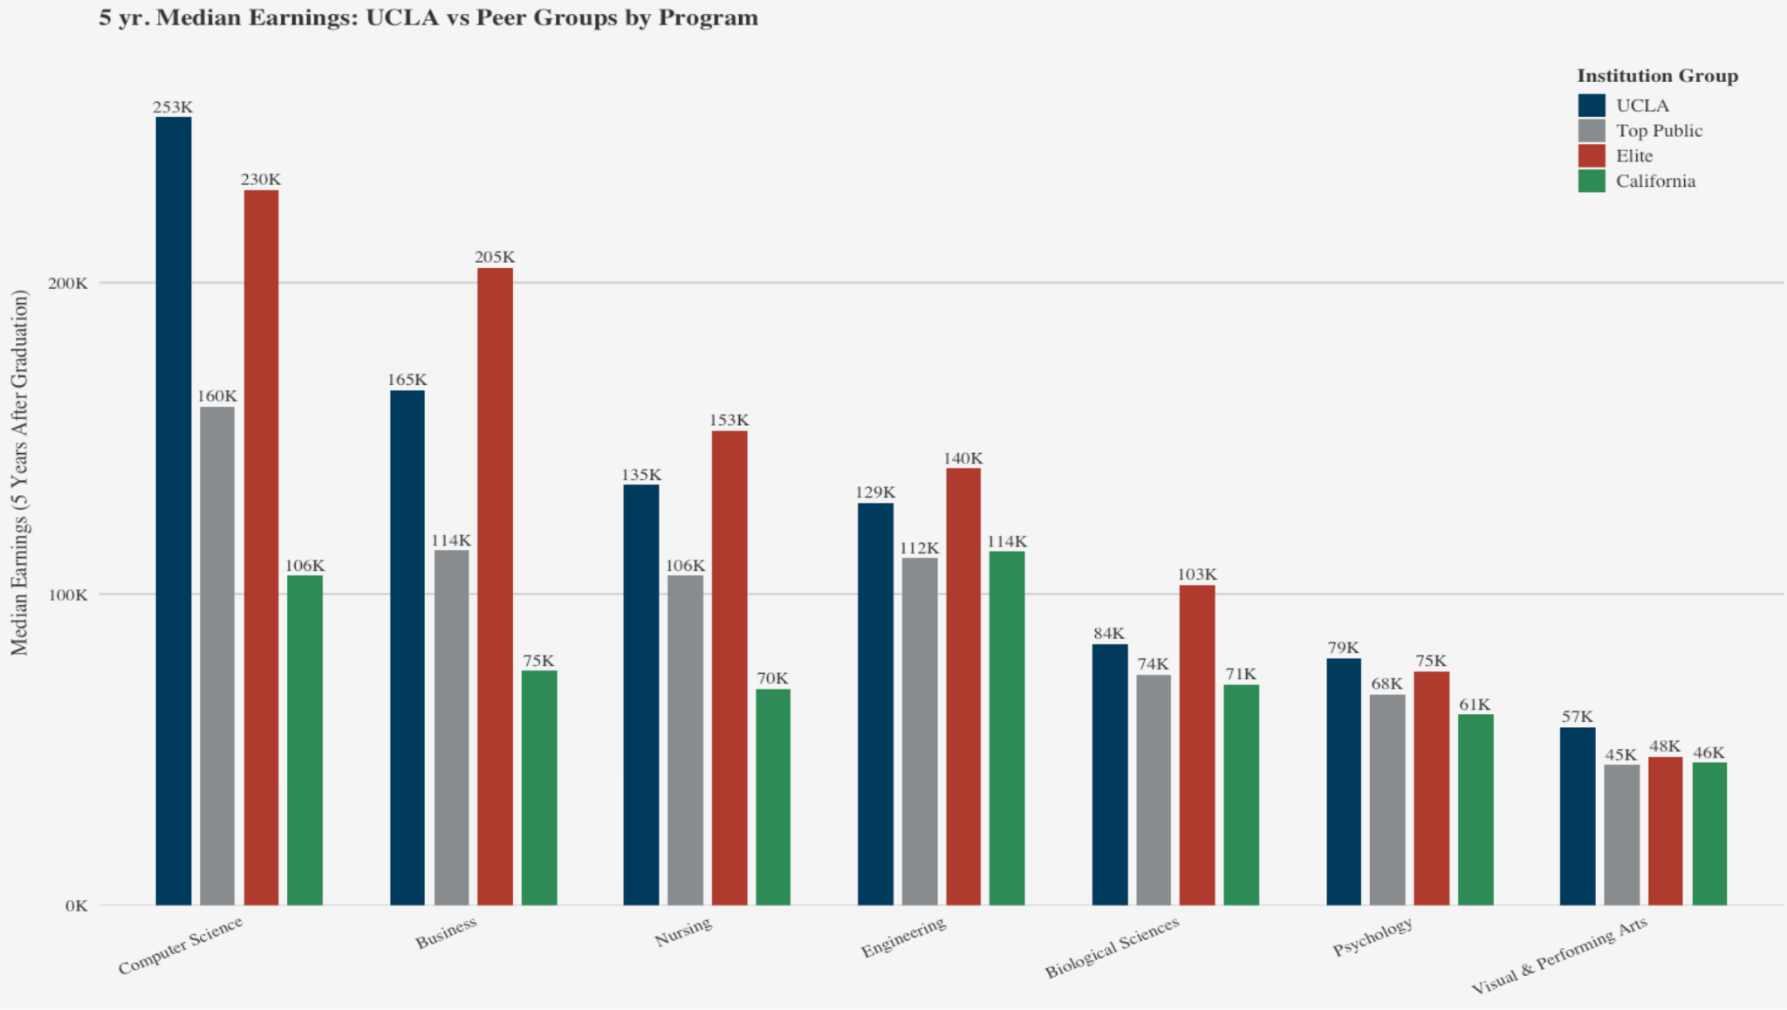
Program Comparisons
Comparing UCLA to the previous groupings of colleges across various programs
Notes:
Why chose these programs

Slide 16
Graduate Cohort Size and Earnings Trends

Slide 17
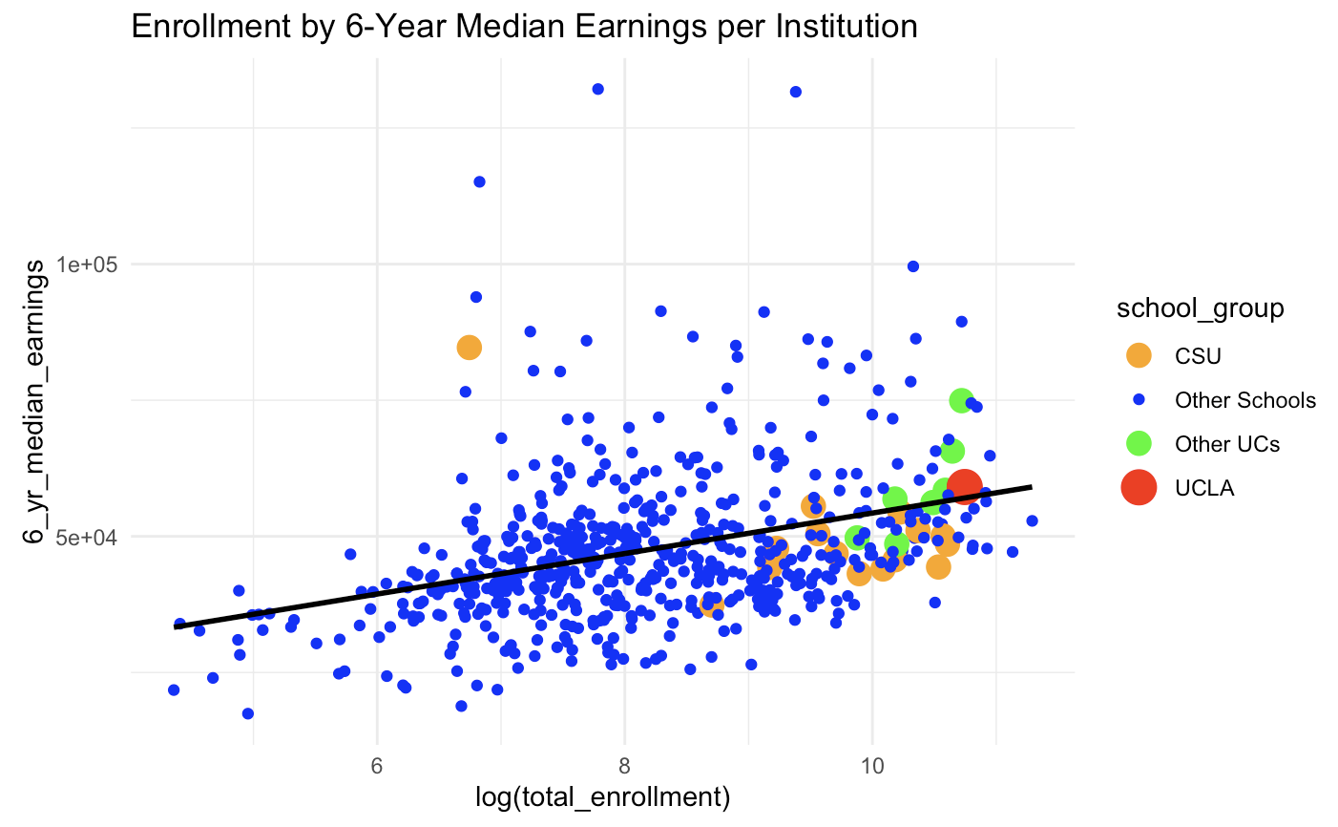

Slide 18
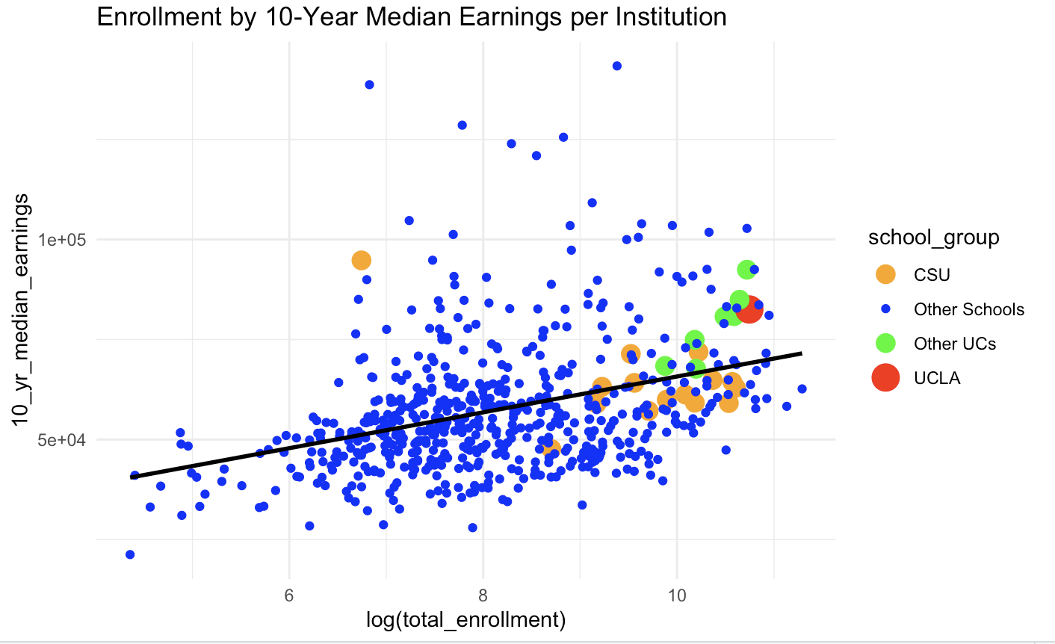

Slide 19
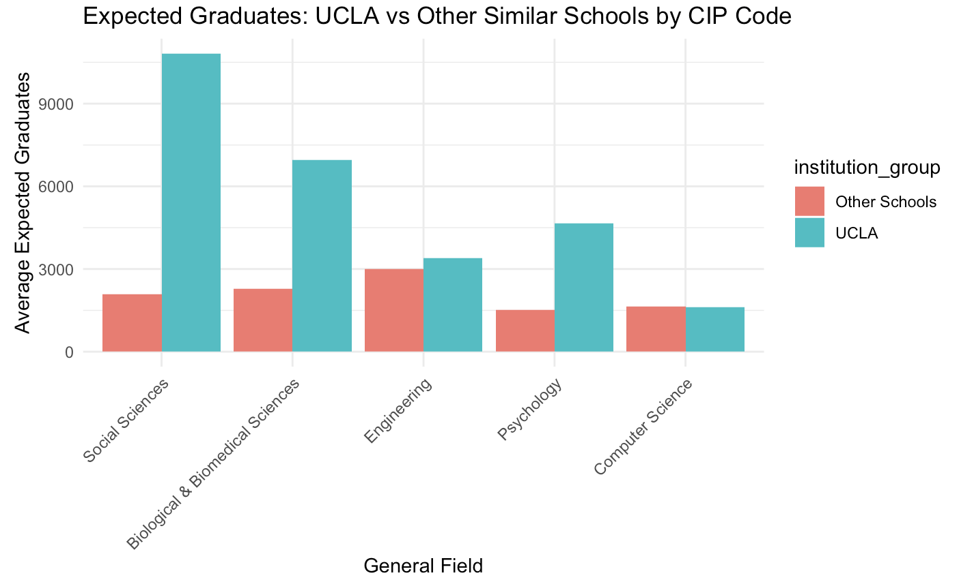

Slide 20
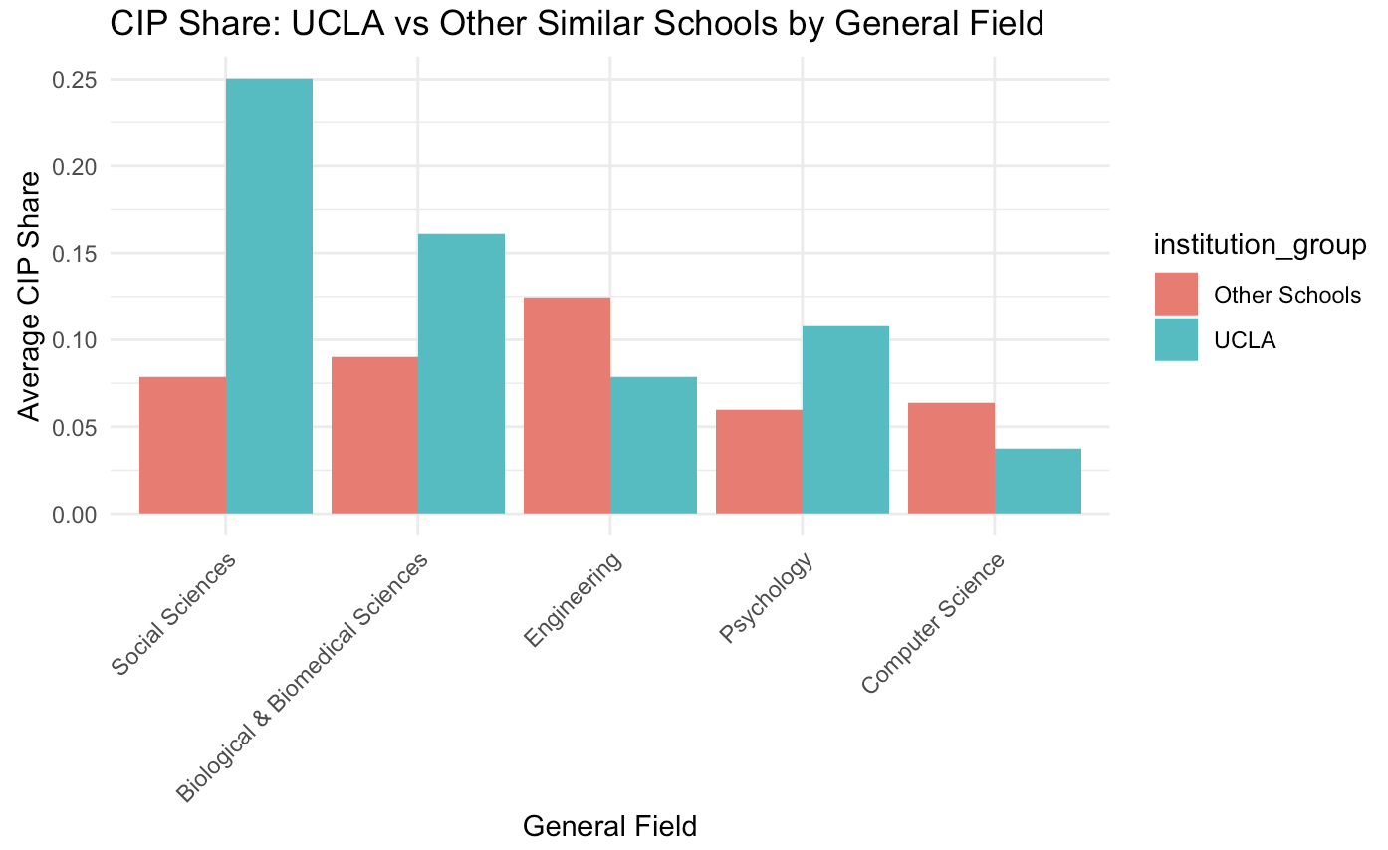

Slide 21
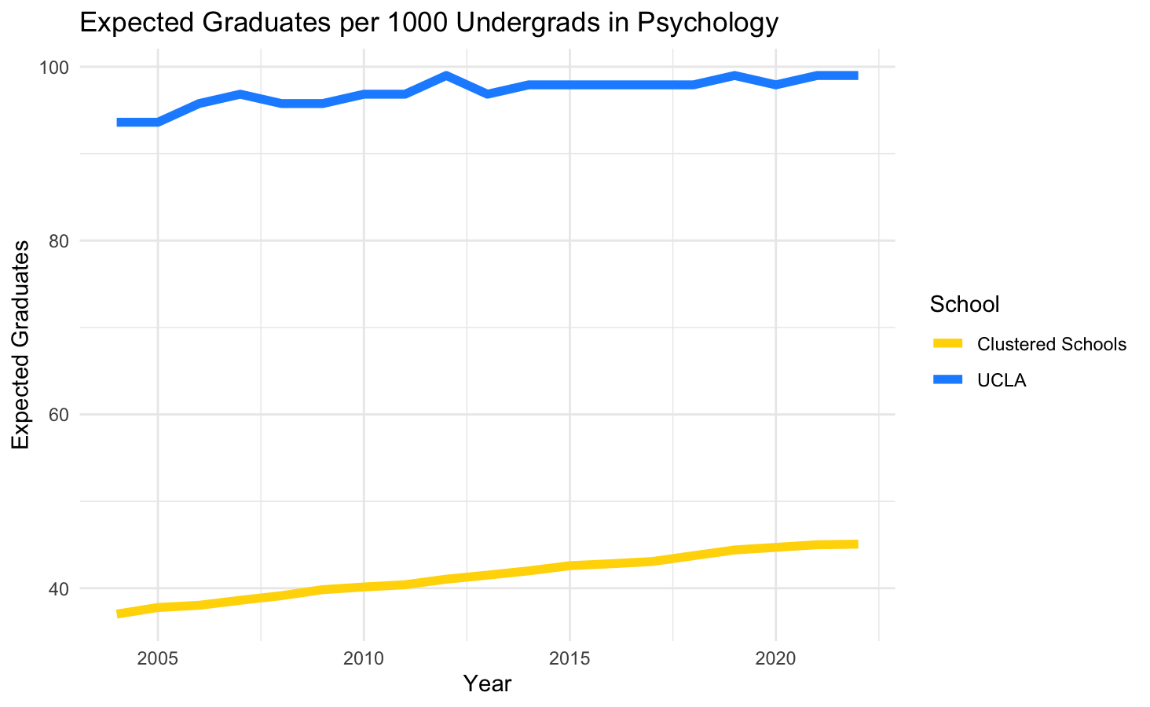
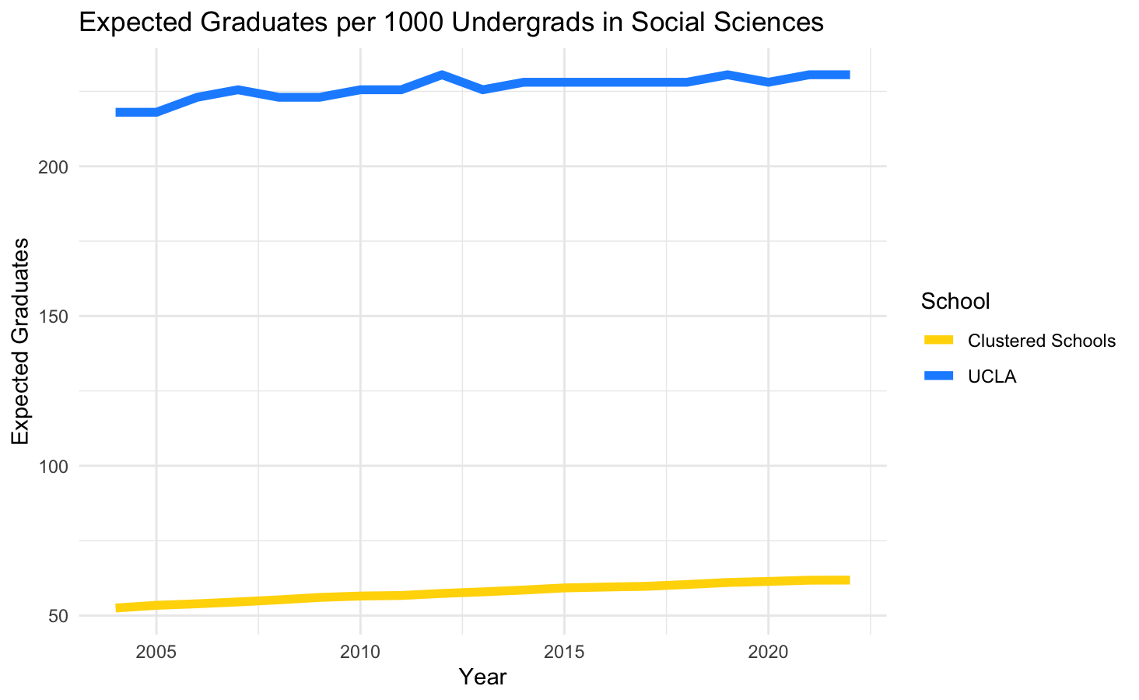
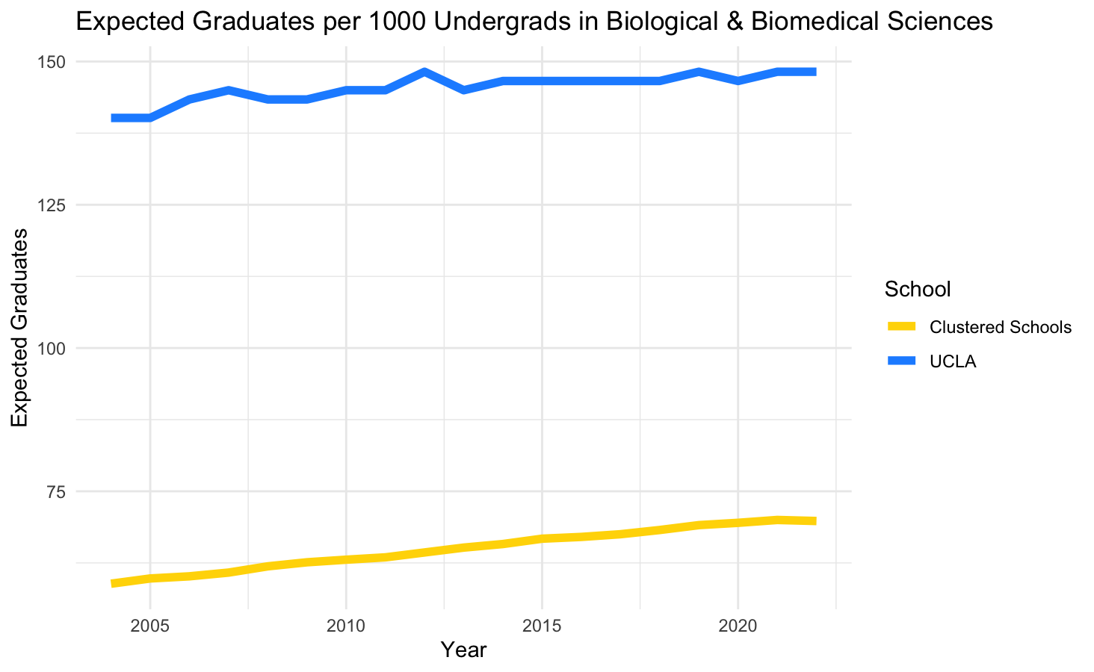
These plots help answer “for every 100 undergraduate students at a school, how many of them do we expect to graduate in a specific field?”
We’re also able to assess how this rate of expected graduates in these fields have changed over the last 20 years

Slide 22
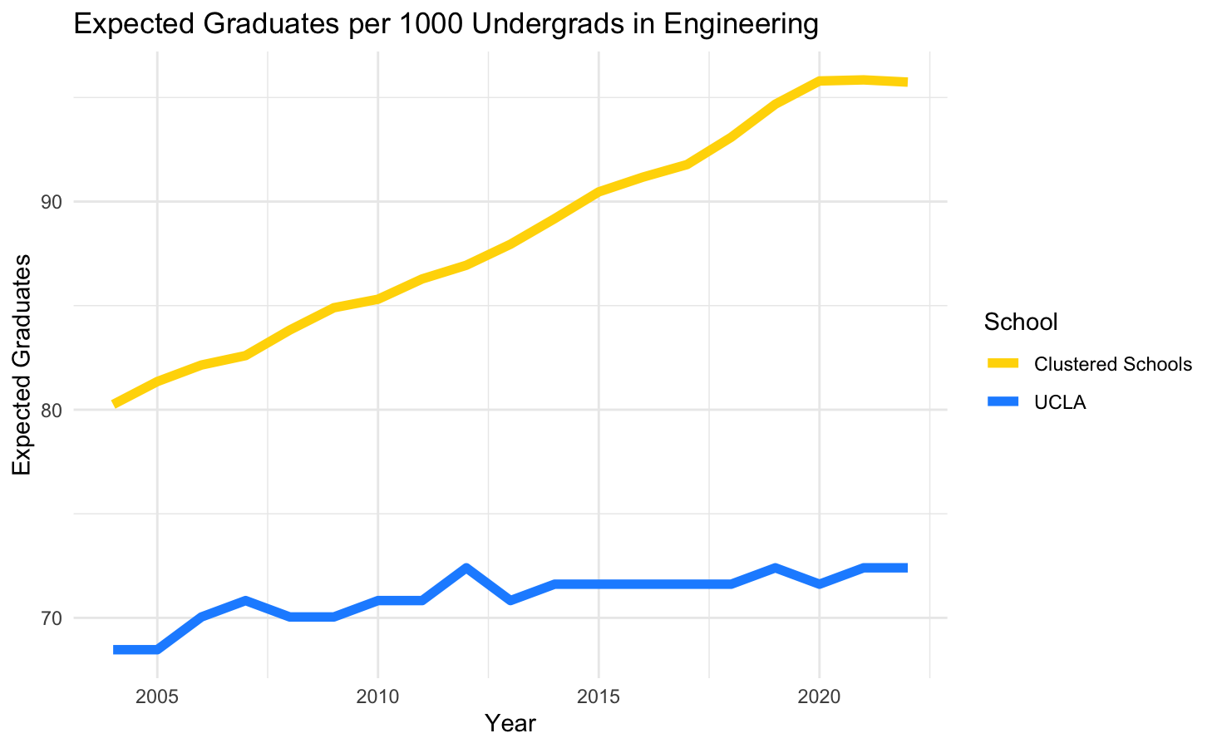
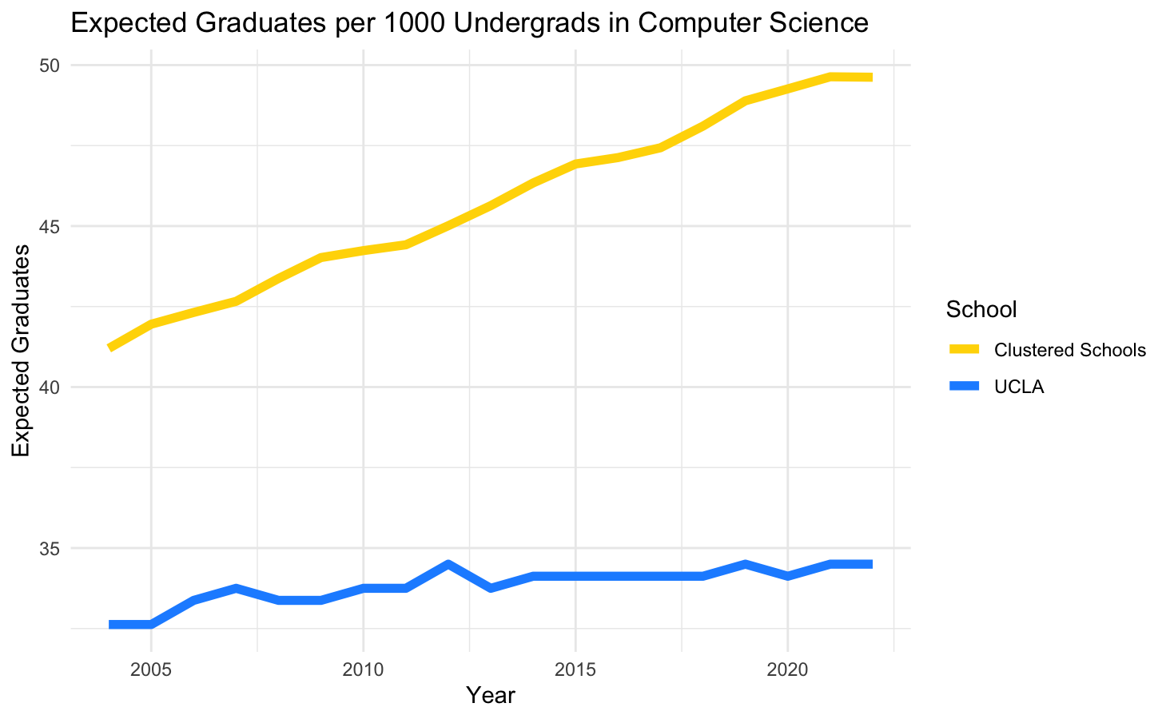
Widening gap between UCLA and clustered schools over time in these major STEM fields
What might we attribute this to?
Selectivity(~5% for Samueli)
Direct admission
Student demographics
Physical capacity(UCLA has added less STEM space than other schools)

Slide 23
Earnings Benchmarks and Distributions

Slide 24
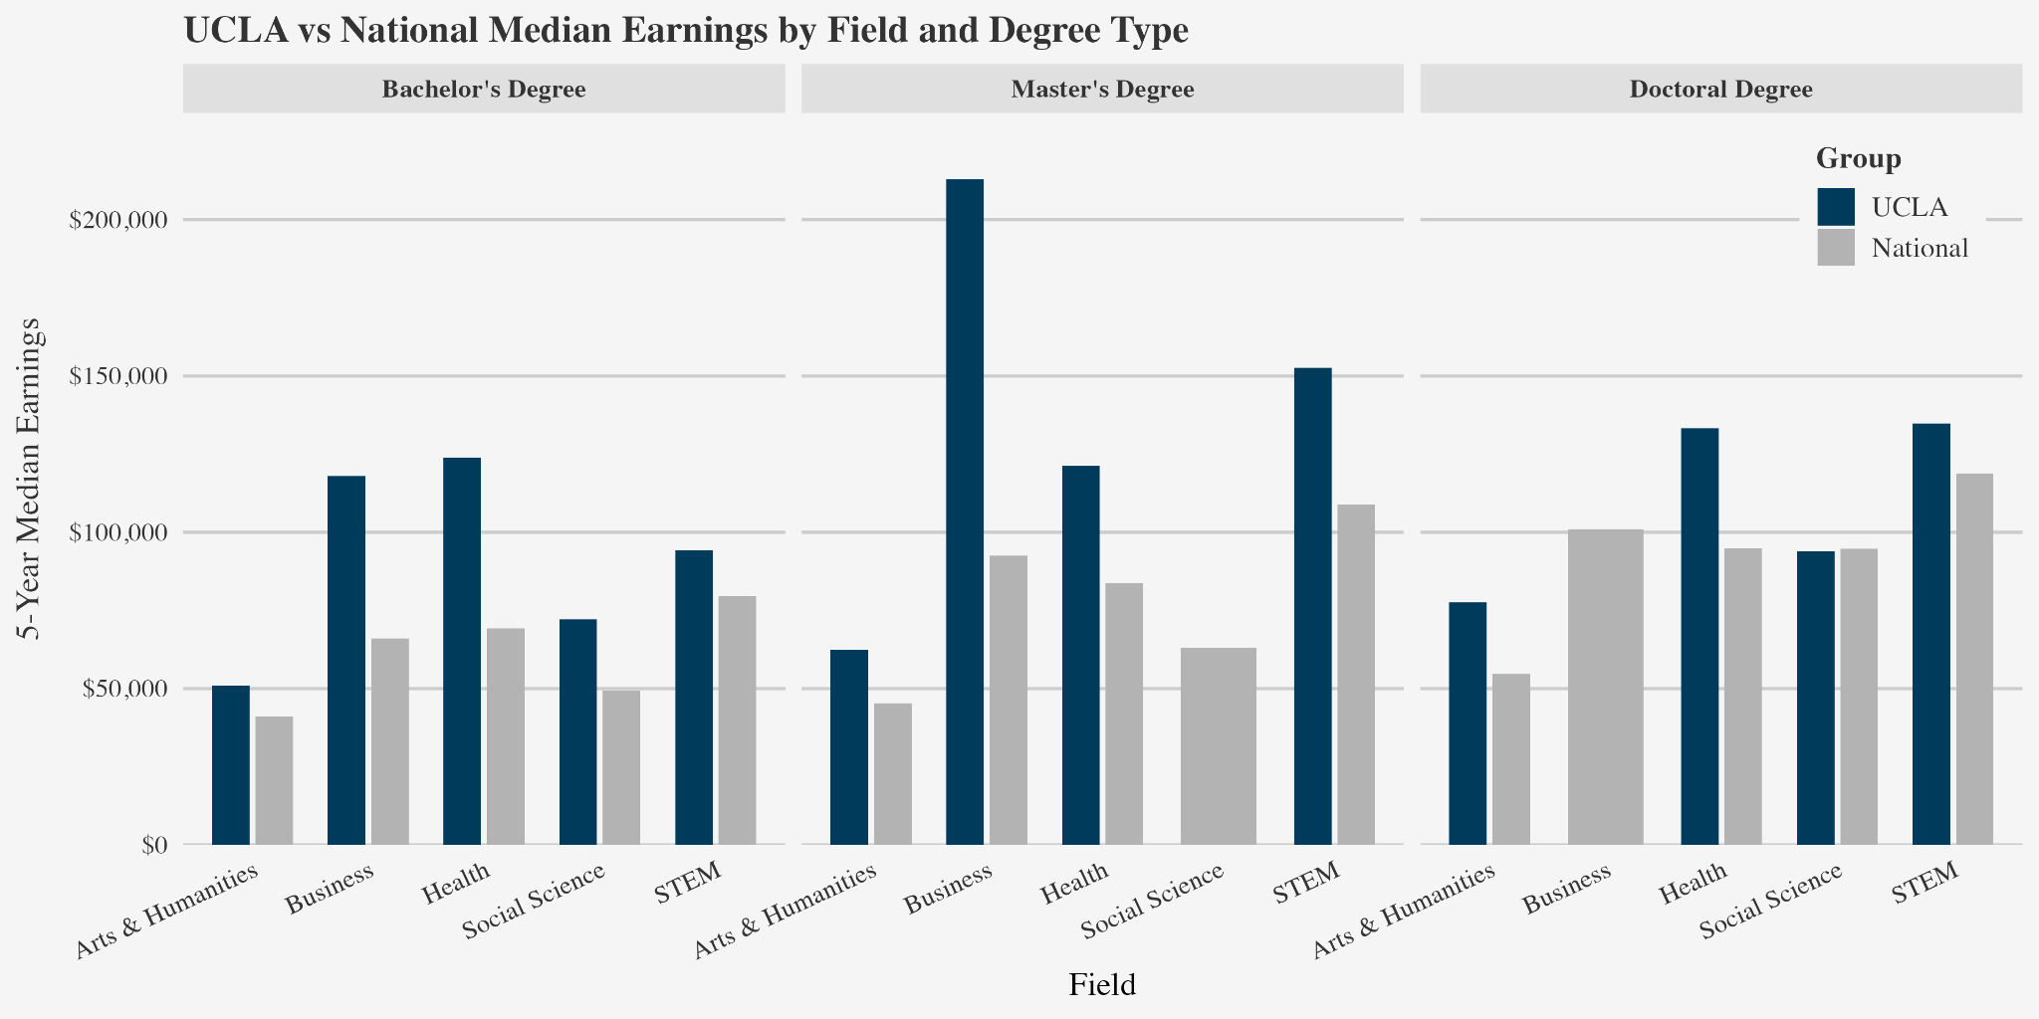
UCLA programs compared to national averages grouped by field
Notes:
General medians for groupings of programs for each degree type
5 general groupings

Slide 25
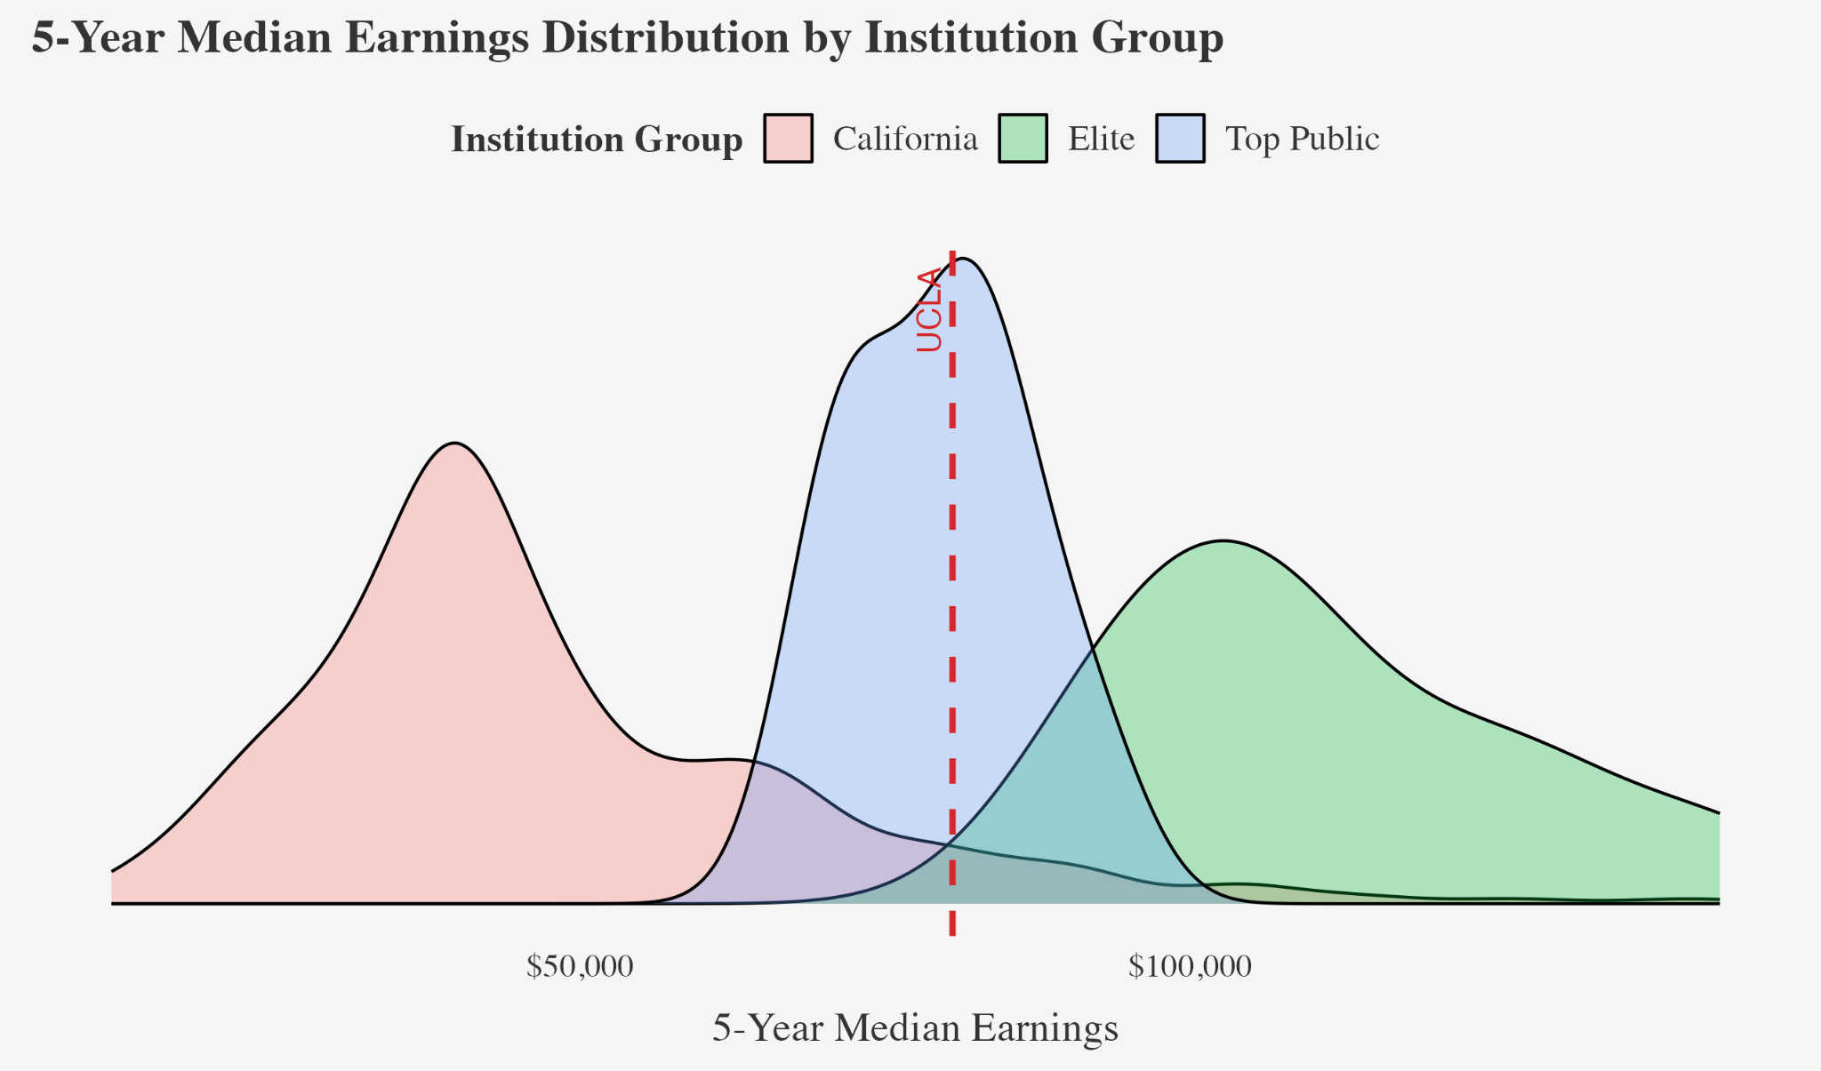
UCLA’s placement in the earnings distributions of the groupings of schools

Slide 26
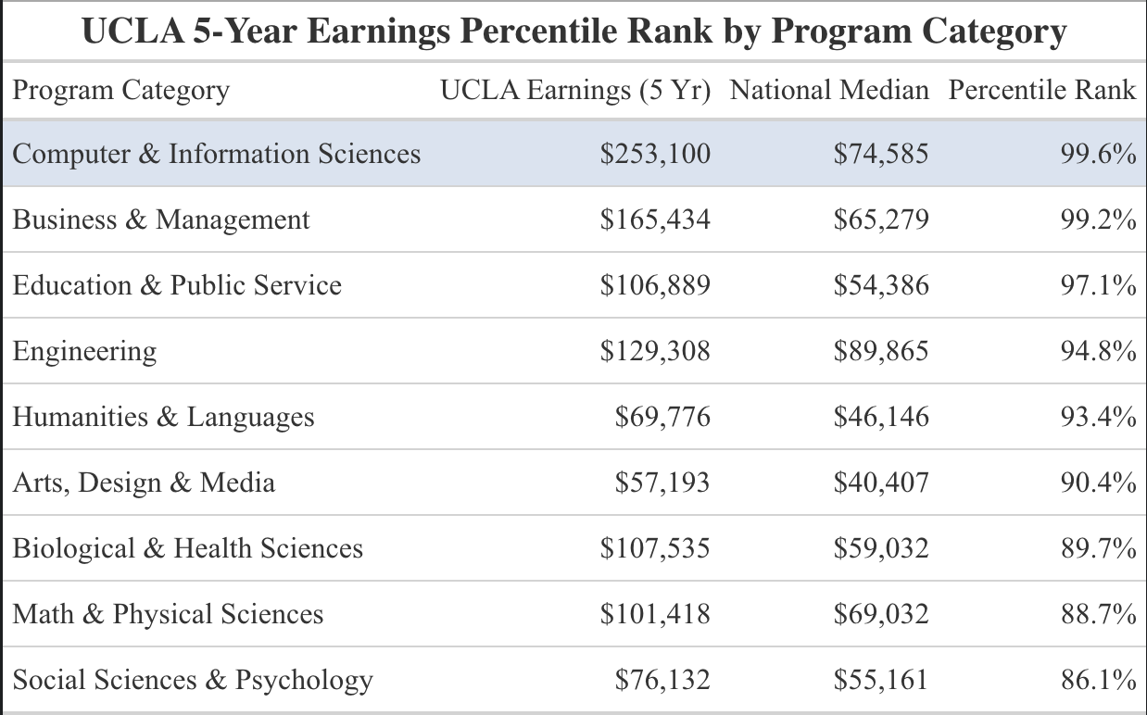


Slide 27
Implications
UCLA consistently above 85th percentile
Reaches 95-99th percentiles in competitive fields
Contends with even top private institutions
UCLA offers a comparable education and outcome to ivies for significantly lower price and to more students
Continue to monitor and report outcomes to ensure UCLA continues this pattern

Slide 28
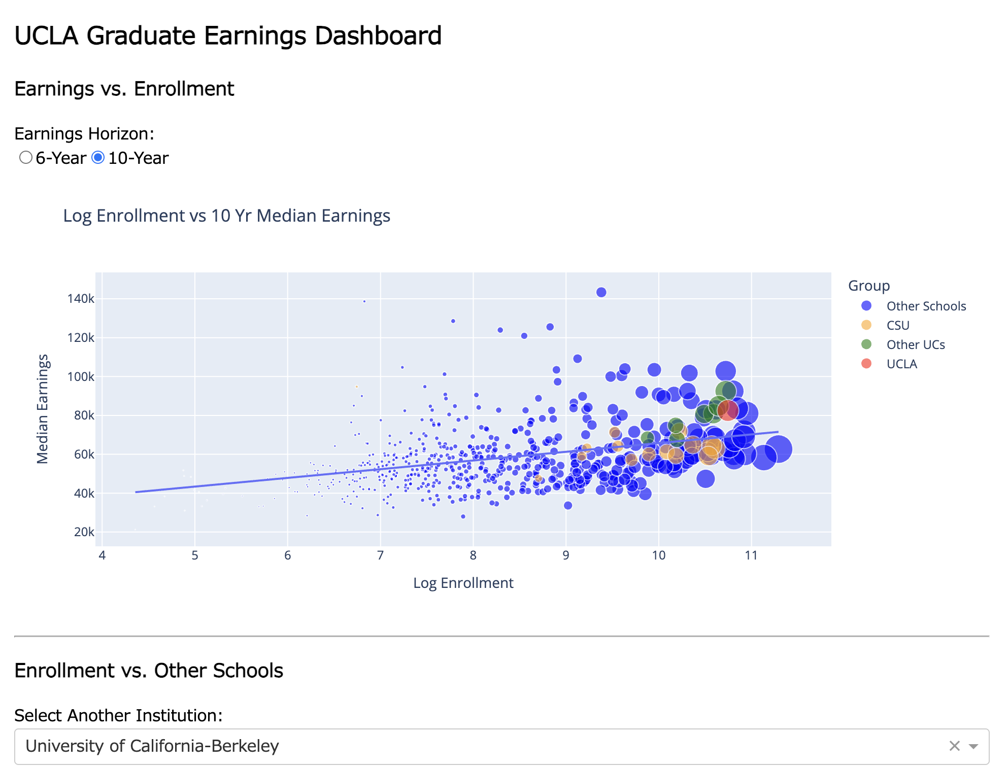
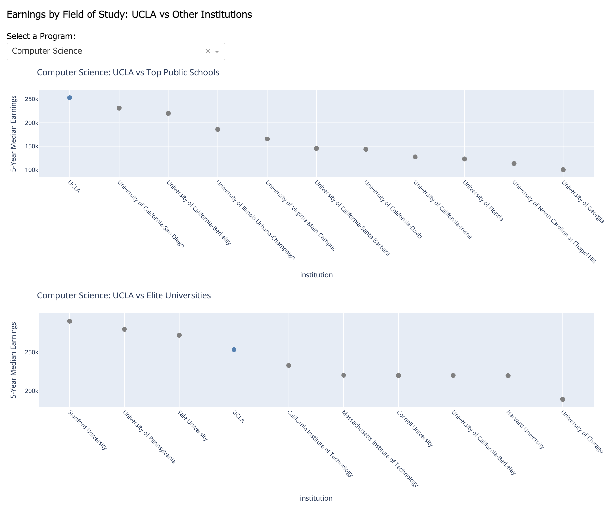
Earnings and Graduate Outcomes Product: Dashboard
https://ucla-earnings-dashboard.onrender.com/

Slide 29
Institution Level Analysis

Slide 30
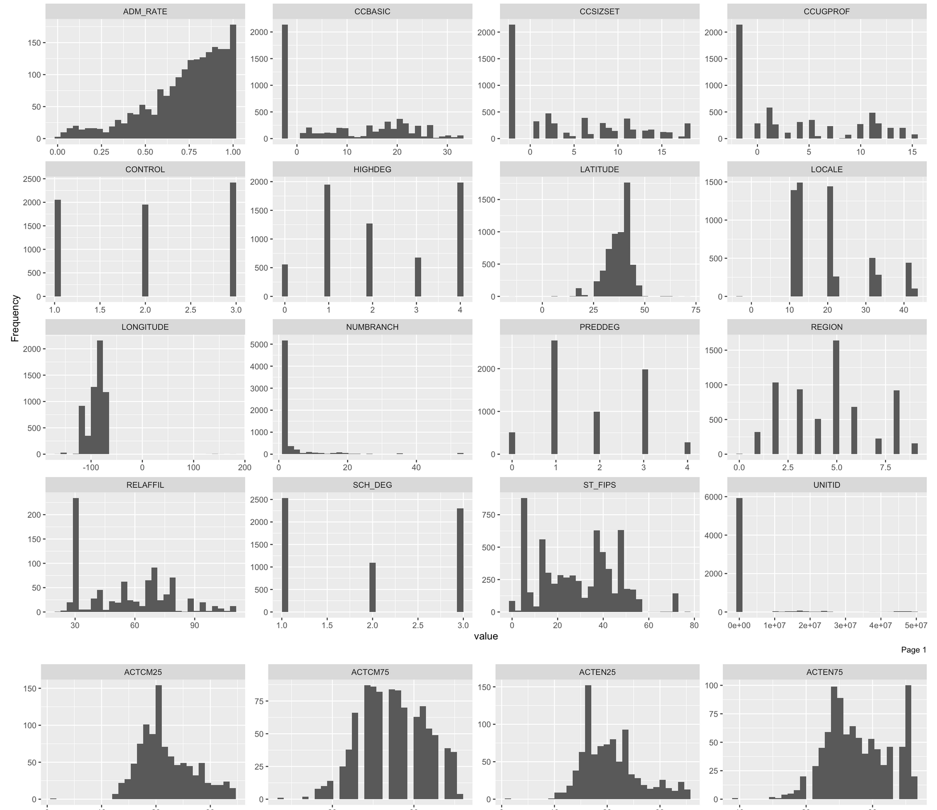
Data exploration: Distributions

Slide 31
Defining “Peer Institutions”
Methodology:
Variable selection for institutional characteristics related to earnings
Mixture of missingness analysis and looking at papers
Non-parametric imputation
Using MICE and RF
HDBSCAN clustering
Finding the “true clusters” in the data
Variable importance
What created these clusters?
Defining a metric
How do we quantify student income?
Institutional factor analysis and comparisons
What causes differences in financial success and how does UCLA stack up?

Slide 32
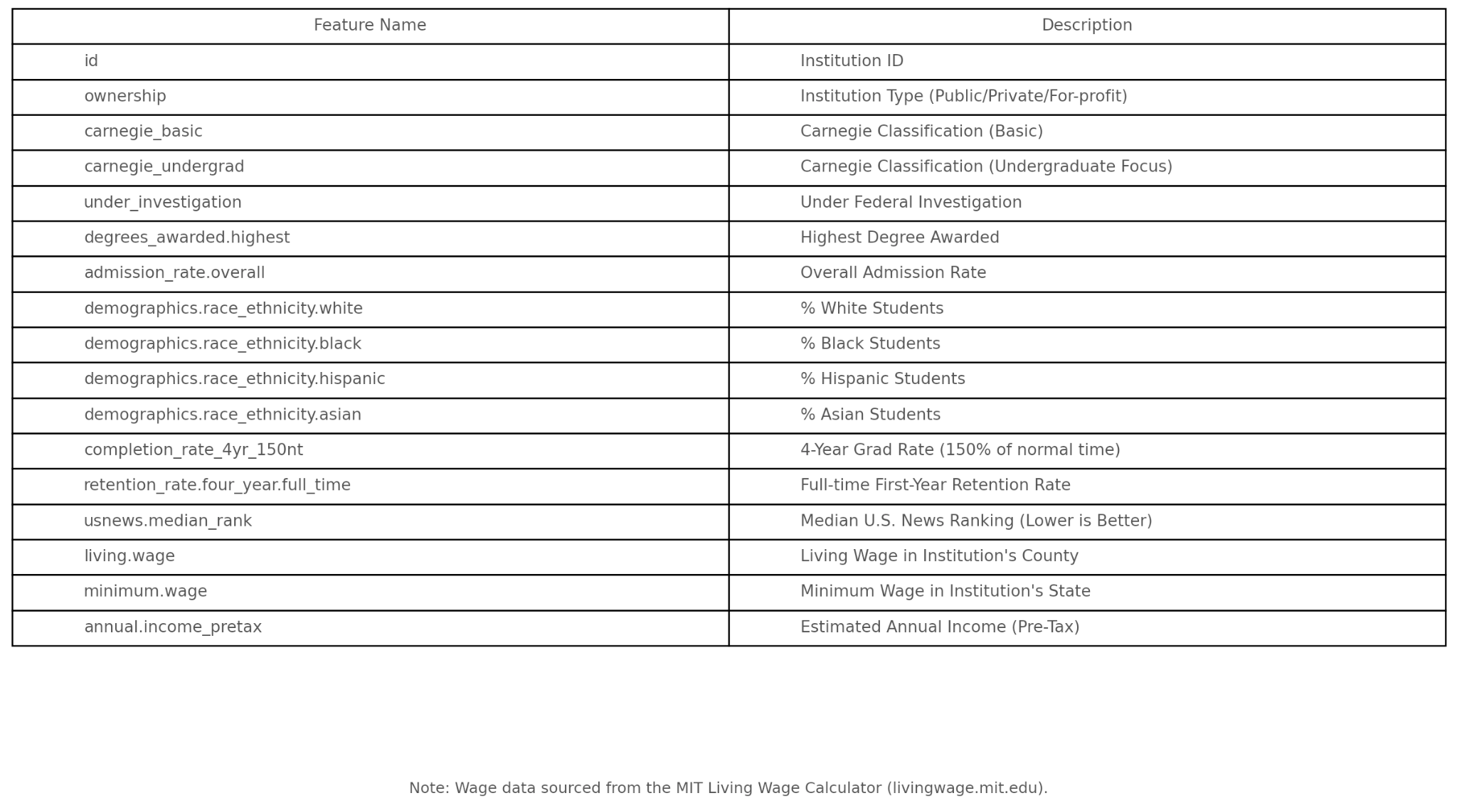
Variable Selection

Slide 33
Imputation and Clustering
Using MICE and Random Forest
Non-parametric imputation to account for the lack of normality amongst the distributions of many of the selected variables
Initial clustering:
Peers defined as
Cal State Campuses
UC Campuses
Caltech

Slide 34

New Clustering
Clustering WITHOUT demographic variables
Including aggregated college rankings in the equation
Aiming for less geographical relationships
More institutional similarity
Defining peer institutions nationally:

Slide 35
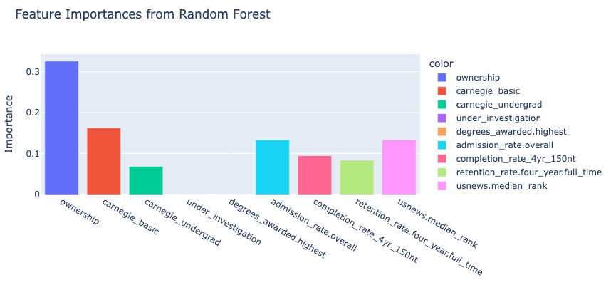
New Clustering
What determined these clusters? (using a RF model fit on the cluster outcomes)

Slide 36
Defining a Financial Metric
Using early career (defined as 1-5 years) median earnings from each university
All universities in the US News Rankings data
1 year post-grad
4 years post-grad
5 years post grad
Adjusting for location and cost of living
MIT living wage calculator data for livable wages, annual pretax income information
Cost of living used due to statistics mentioning a large tendency for many students to remain within 200 miles of university locations (note: this is based on reports from individual colleges and is considered an assumption here)
Creating a ratio between pretax income and livable wages to represent how much “better” than average salaries were

Slide 37
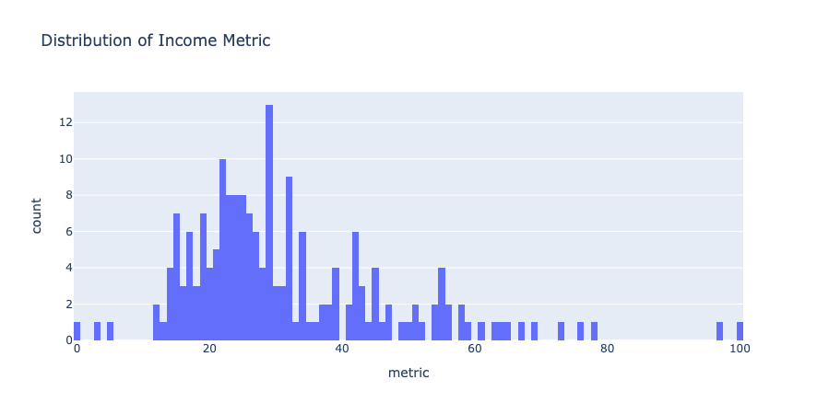
Defining a Financial Metric

Slide 38
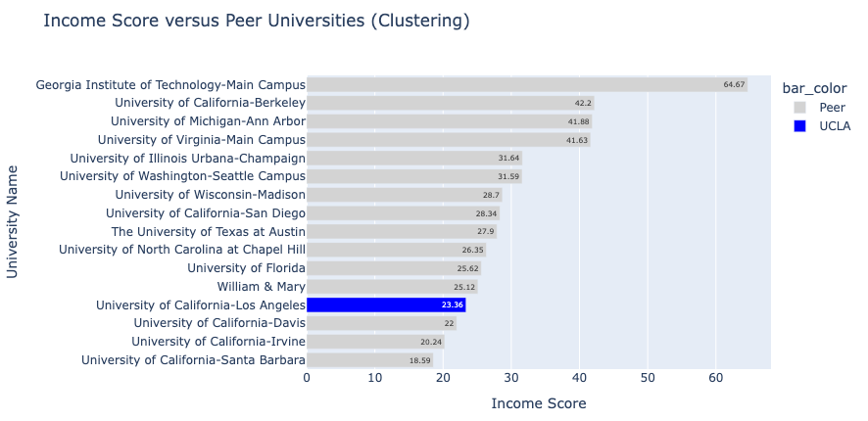
How does UCLA compare?

Slide 39
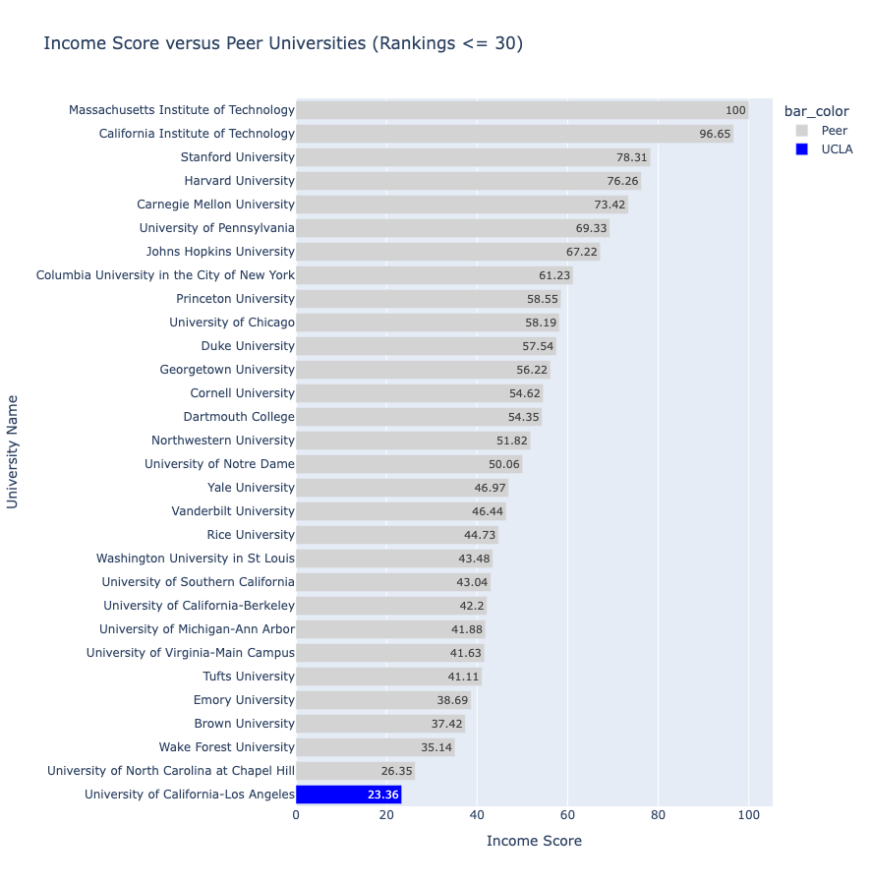
How does UCLA compare?

Slide 40
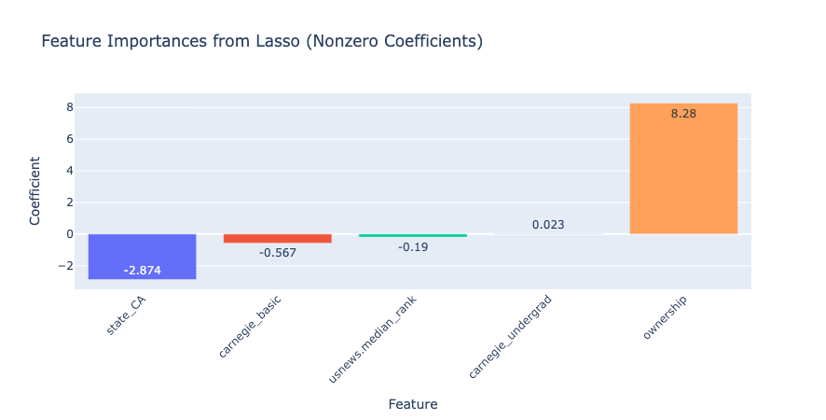
What factors affect income?
Using all of our features from variable selection and predicting our financial metric

Slide 41
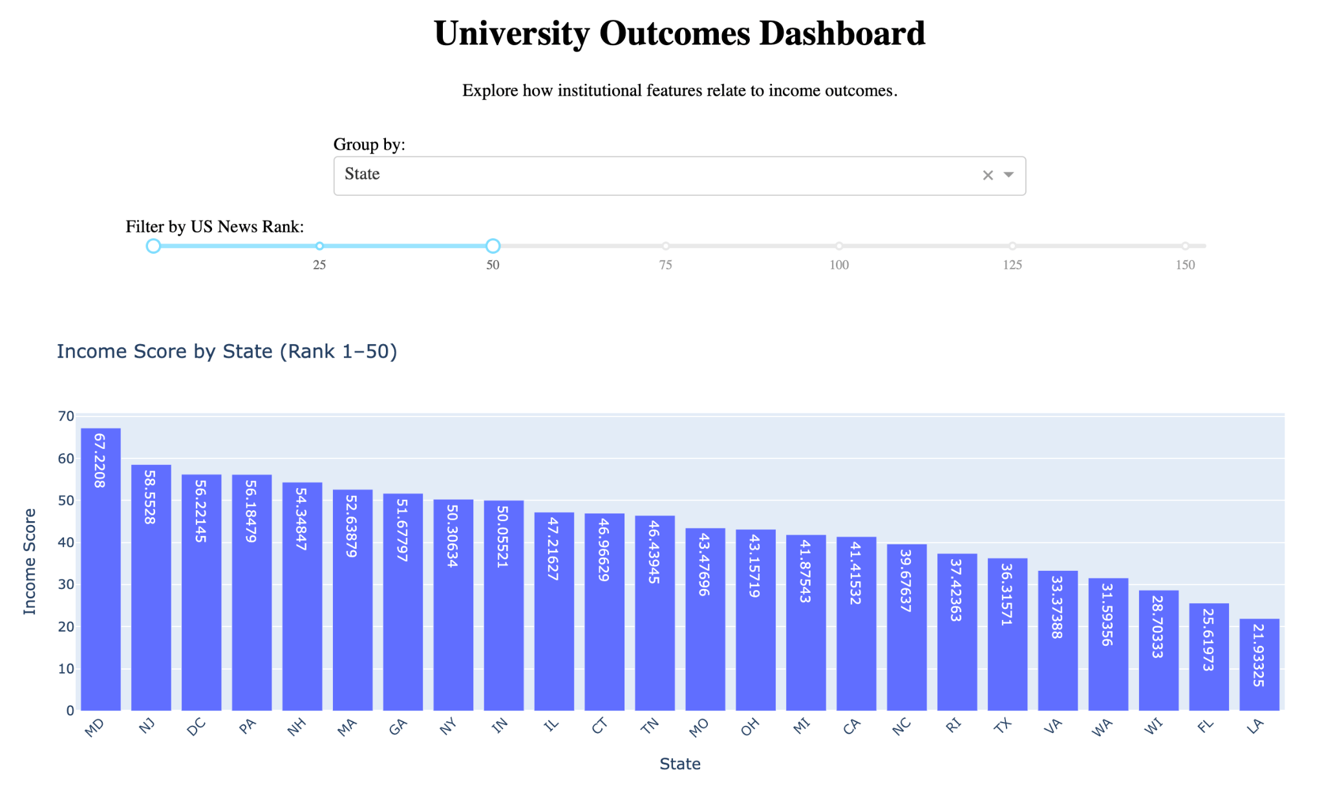
Institutional Factor Product: Dashboard
An interactive look at the effect of institutional factors on our financial metric
https://one41xp-income-dashboard.onrender.com/

Slide 42
Suggestions for the Future (Prompt 1)
Challenges:
Missing & Privacy Suppressed data
Uneven program coverage across schools
Ivies especially do not offer as many low earning majors, skewing institutional comparisons in UCLA’s disfavor
Ambiguity in matching “similar programs”
CIP prefixes are extremely broad
Suggestions:
Gather more data from a source outside of Scorecard and IPEDS, especially for graduate level programs
Analyze across wider range of programs and investigate specific programs in more detail (4 digit CIP codes)
Explore alumni career outcomes from non-monetary sources (ie: LinkedIn Scraping)

Slide 43
Suggestions for the Future (Prompt 2)
Challenges:
Gathering data was difficult due to not having access to readily available CSVs for certain variables
Had to go through various APIs and many different web sources to find the right data
Creating new variables derived from known variables (ex: estimating expected graduates from total enrollment and graduation rate)
Suggestions:
Further analyze the relationship between median earnings and predictors like enrollment and graduation rate through a more sophisticated model than linear regression
Conduct a more thorough analysis that considers additional institutional factors such as rankings and economic variables(unemployment, tax rate, etc.)

Slide 44
Suggestions for the Future (Prompt 3)
Challenges:
High missingness for Master’s and Doctoral Programs
Raw CIP data is difficult to visualize and communicate without grouping into broad categories
Suggestions:
Utilize quantile regression to explore more in depth how UCLA compares to low and high earning ends instead of just average
Examine longer term longitudinal outcomes beyond 5 and 10 years after graduation

Slide 45
Suggestions for the Future (Prompt 4)
Challenges:
Uniqueness of UC institutional characteristics
The demographics, student selection criteria, and subject focus of the University of California system lead to a misleadingly low financial metric score
Limited set of institutional factors
Suggestions:
Incorporation of subject area based weighting for financial metric
Further quantification of institutional characteristics to capture more aspects
Looking at policy for instance
Feature engineering

